Slide 1

CityDog
Mike Young | CEO DevLab
Notes:
Good morning/afternoon.
I’m Mike Young, CEO of DevLab here today to present you with…
Market and competitor analysis, areas of growth and where our product, CityDog can capture market share.
Brief intro of the product, what is CityDog, then what does the app do.

Slide 2

“My dog is part of my family…”
Notes:
Most pet owners in Australia consider their dogs part of the family and want to take them wherever they go.

Slide 3

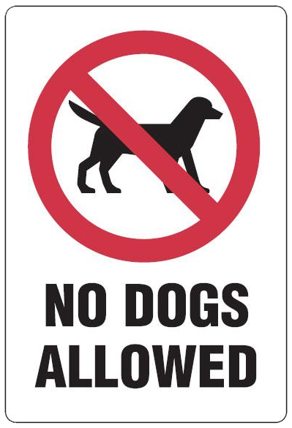
“but where can I take him?”
Notes:
The problem is dogs are not always welcome….
So how can I find out where I can I take, when I want, where I want?

Slide 4

Where can I?
Where can I take my dog and have a coffee or bite to eat?
Where are the best places to walk my dog and meet other dog owners?
Where can I get the best deals on products for my dog?
Notes:
So where can I take them? And how can I find out?

Slide 5

App features
Set milestones and win rewards!
Find and create walking routes.
Find nearby shops, events and products that are dog friendly.
Automated and user prompted social media updates.
Notes:
Enter CityDog, giving you access to information where and when you need it.
But CityDog is more than just a directory for dog friendly cafés…It’s the complete app for dog lovers with features like walking route suggestions, local dog parks, rewards for hitting milestones and visiting new locations. It’ll even tell you where you can find that new pink walking lead you’ve been after, locally.

Slide 6
Market overview
92%
have a
smartphone
$3.6B
spent on dogs in 2009
Market opportunity
Australians spend a lot of money on keeping their canine family member happy.
How can we get a slice of this?
3.4 million dogs
Notes:
11.2 million smartphone users
In 2009 Australians owned 3.41 million dogs

Slide 7
Market analysis
36%
that’s 16 dogs for every 100 people!
60%
of a whopping $6.02 billion pet industry was spent on dogs alone in 2009, that’s $3.6 billion.
of households own dogs
of industry spend
Notes:
36% of Australian households own a dog, that’s 16 dogs for every 100 people!
In 2009 Australians spent $3.6 billion on their dogs, accounting for 60%

Slide 8
Asia-Pacific market
$1,056
Average annual dog owner’s spend on their pet
Australia
4%
$1,571
Average annual dog owner’s spend on their pet
New Zealand
growth
50.8%
Japan’s share of Asia-Pacific market
USD $11.3
Japan
billion
43.8%
share of total Asia Pacific market
dog care
Notes:
Pet product market
APAC 4% overall growth, worth 11.3 billion US in 2012
References:
Australian Companion Animal Council report (July 2011)
New Zealand Companion Animal Council report (2010)

Slide 9
Revenue streams
Lead Generation
Advertising
Partner Programs
Referrals
Users of the app form a leads database which can be sold to pet product providers and lead resellers.
Advertising is the primary source of revenue.
Targeted advertising opportunities within the app, delivered at the right moment.
Direct partnerships with pet industry leaders will generate revenue through commission and targeted advertising campaigns.
Referral programs provide revenue if a customer downloads or purchases a partner app.
Notes:
Target partners are those responsible for the largest pet industry market share, namely dog food manufacturers, vetinerary services, insurance providers and accessory manufacturers (check these against market report).
Referral partnerships such as Upsight (who now own Playhaven) help boost downloads of apps and create revenue when CityDog users download other apps.
Check lecture notes for their definition of revenue streams

Slide 10
Marketing strategy
Merchandise
Distributed through industry events, dog groups and dog parks.
Reviews
10%
40%
User and professional reviews are key to getting noticed for any app.
10%
Printed Media
Traditional printed media distributed at partner cafes, restaurants and events.
20%
20%
Social Media
Auto-posting of user activity to Facebook, Twitter and other social media hubs.
Referrals
In-app advertising of CityDog in referral partner apps.
Notes:
Online, in-app (other apps) referral programs, events at dog parks, partner programs (in window advertising / sticker)
Facebook posts!
Customer relationships are formed through social media, CityDog website updates and in app rewards and notifications.
Digital marketing/branding will include website

Slide 11
Product delivery
Idea
3 month trial
Market analysis
Create base product, test market.
Partner Relationships
Marketing campaign
Foster partner relationships, draw up agreements.
Minimum viable
product
Iterate & innovate
End Goal
Cum sociis natoque penatibus et magnis dis parturient montes.
Expansion
Target revenue reached, CityDog top ranked pet application.
Notes:
We are at the 3 month trial phase with a basic product.
We need to build the multi-platform product, foster relationships with partners and kick off the marketing campaign.
As an app development house we have the resources to build the technical product and with investment can build partner relationships and create a marketing campaign to launch from.

Slide 12
What we need
Australia growth
Worldwide growth
$1M
Cum sociis natoque penatibus et magnis dis parturient.
$4M
Socidis natoque penatibus et magnis dis parturient montes, nascetur ridiculus.
online sales
online sales
$2M
Natoque penatibus et magnis dis parturient montes, nascetur ridiculus.
$8M
Socidis natoque penatibus et magnis dis parturient montes, nascetur ridiculus.
total sales
total sales
80%
Socidis natoque penatibus et magnis dis parturient montes, nascetur ridiculus.
54%
Socidis natoque penatibus et magnis dis parturient montes, nascetur ridiculus.
more clients
more clients

Slide 13
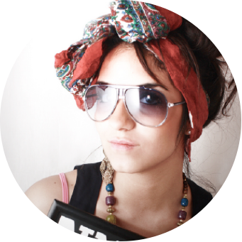



Our team
Helen Daniels
Scott Robinson
Mike Young
Scott Robinson
Graphic Designer
Sales & Marketing
CEO
Technical Architect

Slide 14
Contact
Mike Young | CEO
+ 61 7 3234 1234
citydogapp
citydog@devlab.com.au
twitter.com/citydogapp
facebook.com/citydogapp
pinterest.com/citydogapp

Slide 15
Icon set

